Slide 1
Clustering Project
Bibek Dhungel
Anirudh
Dixa
Harshith
Paderborn | 07.04.2021

Slide 2
Data Pre-Processing
Paderborn | 07.04.2021

Slide 3
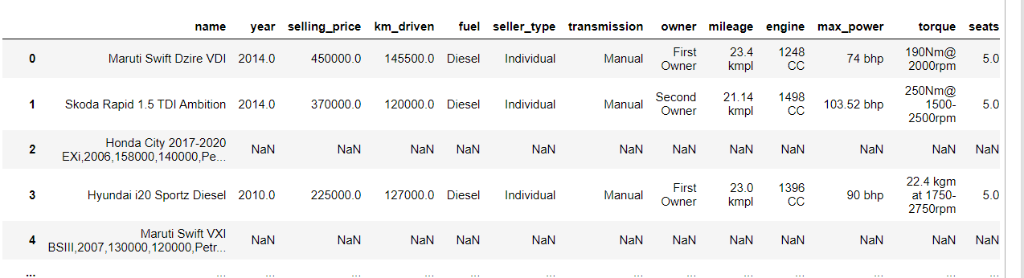
Original Dataset
Consists of many null values
Some Name field have values that has to be distributed along many columns

Slide 4
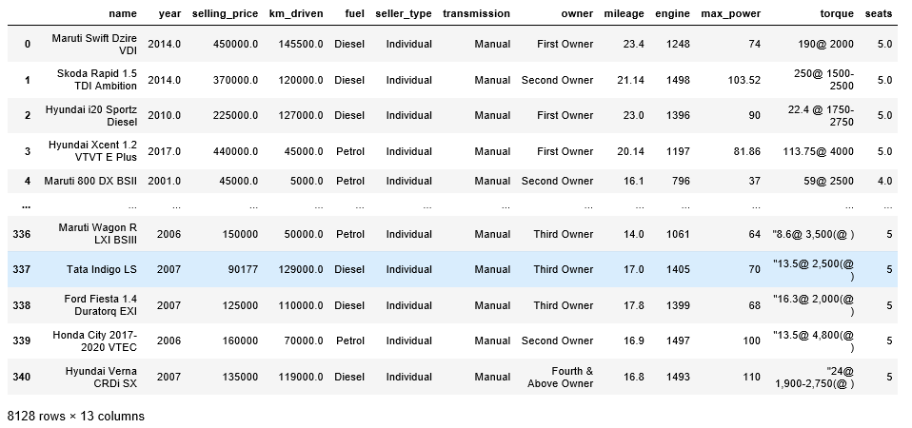
Dataset after fixing Name column

Slide 5
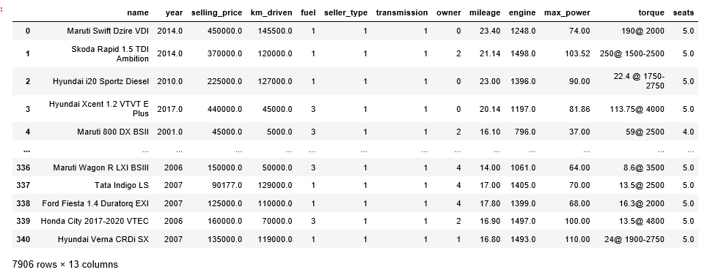
Label encoding is done for fuel, seller_type, transmission and owner columns

Slide 6
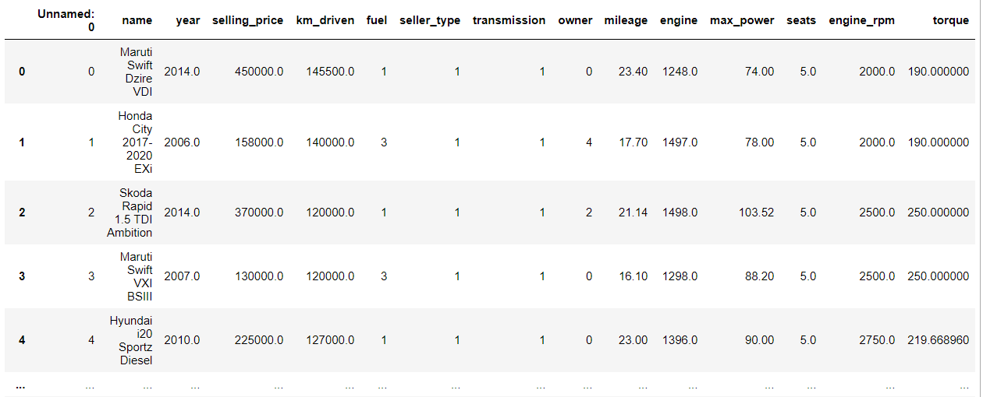
Final Dataset
Distinct outliers and rows with multiple null values are dropped
Rpm and torque is separated and torque values are converted to same unit

Slide 7
DB scan and K-means
Paderborn | 07.04.2021

Slide 8
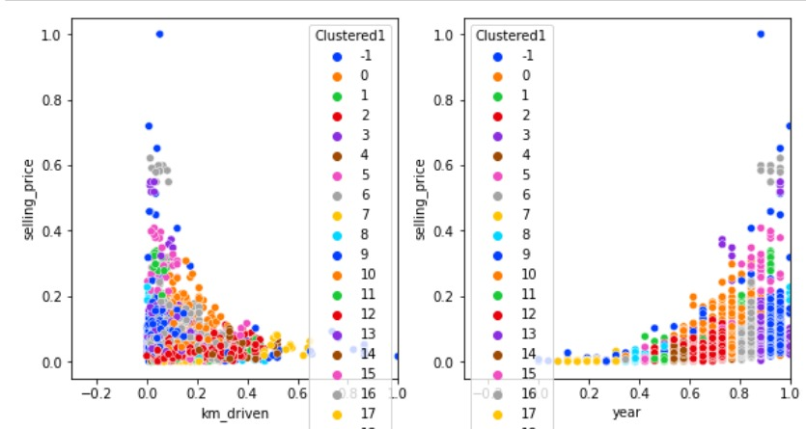
DB Scan
With different parameters, dbscan parameter cannot be figured out with perfection. Different esp. and min samples values are tried with our dataset

Slide 9
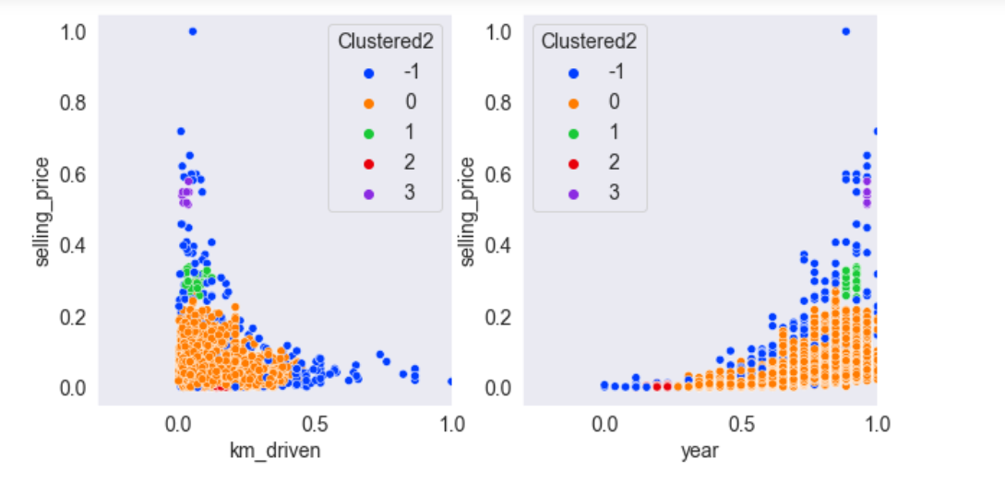
DB Scan
With parameters eps = 0.04, min_samples = 7

Slide 10
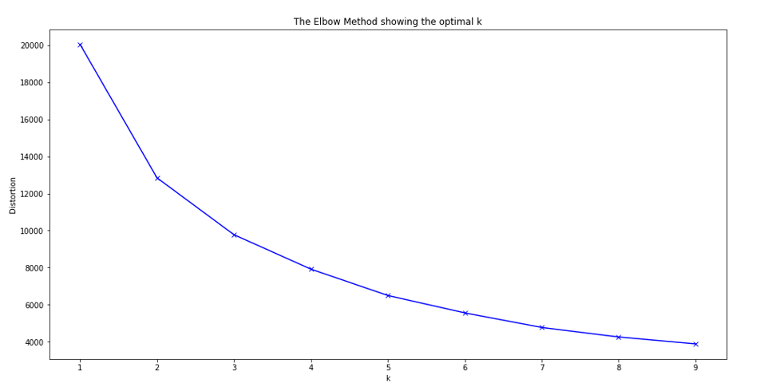
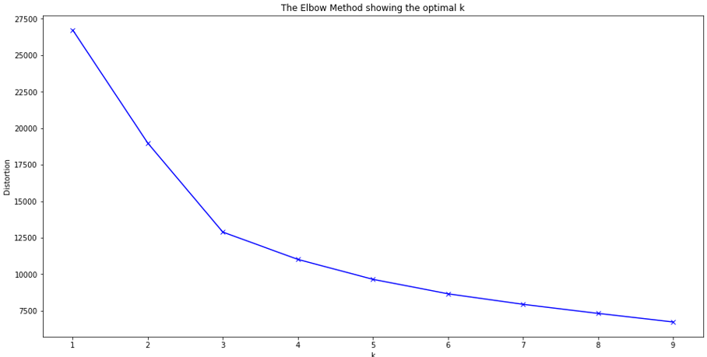
K – Means elbow method
Elbow Method to determine the best K value
Dataset before Normalization: K value = 2
Dataset after Normalization: K value = 3

Slide 11
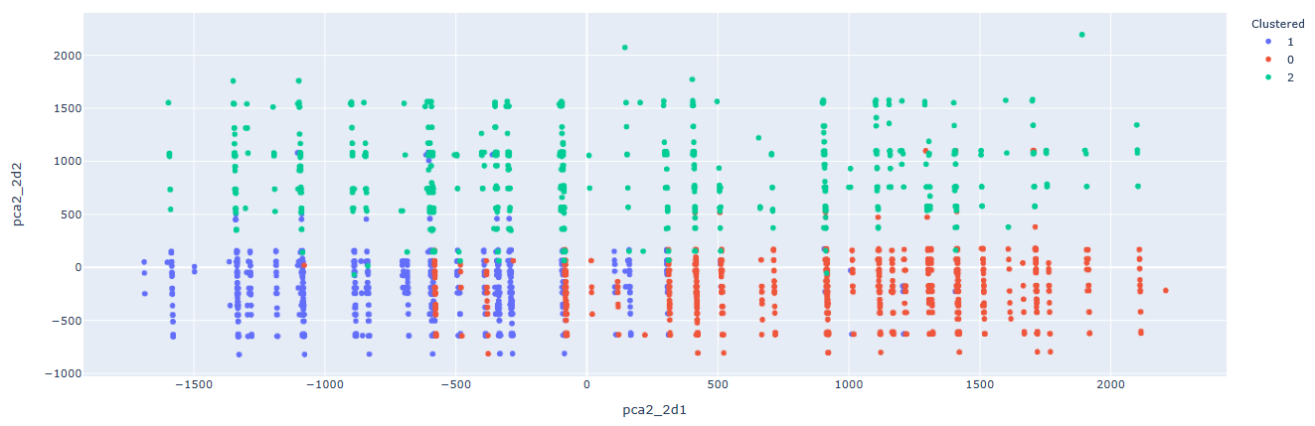
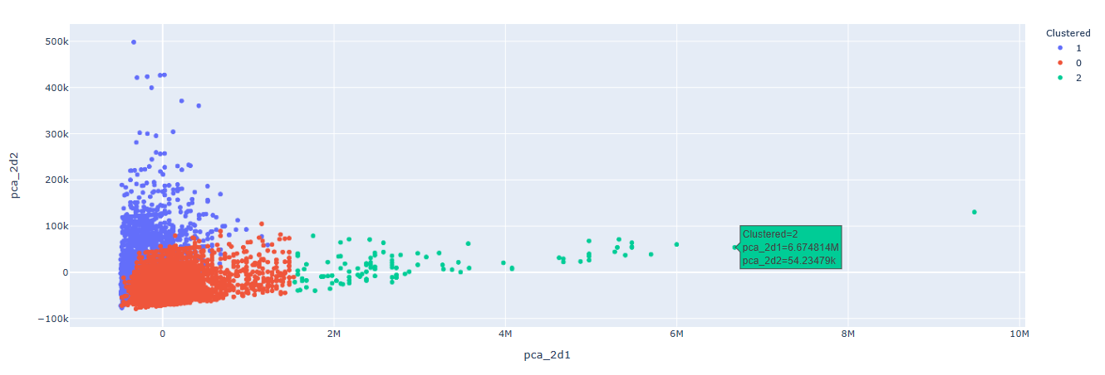
Multi-Dimensional plot - 2d

Slide 12
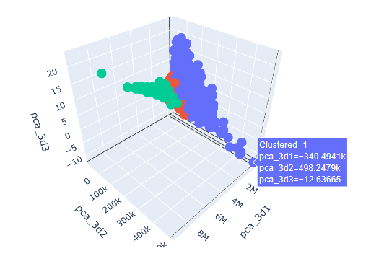
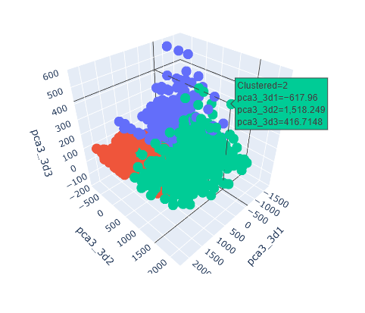
Multi-Dimensional plot - 3d

Slide 13
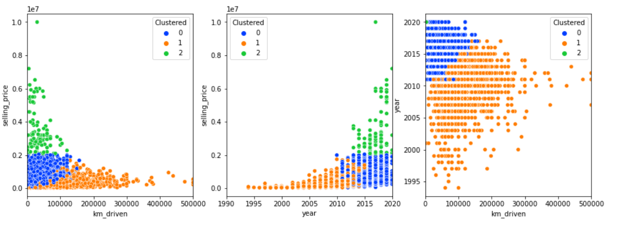
Clusters generated by K means

Slide 14
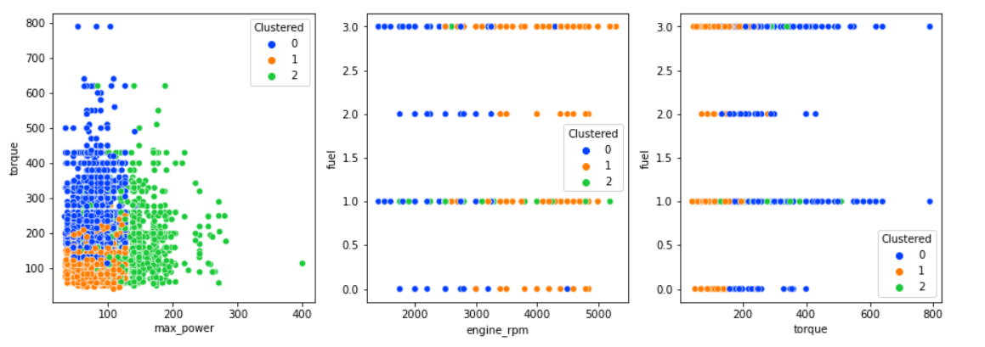
Clusters generated by K means..

Slide 15
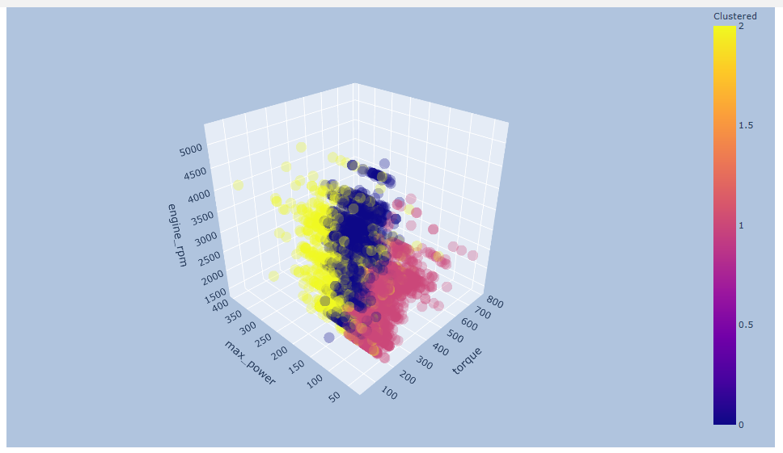
3D scatter plot

Slide 16
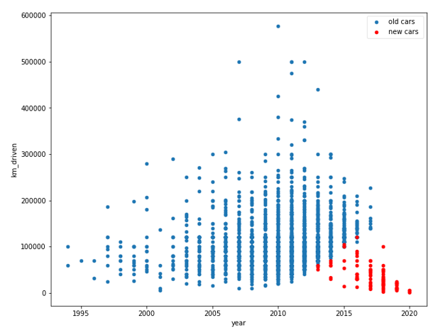
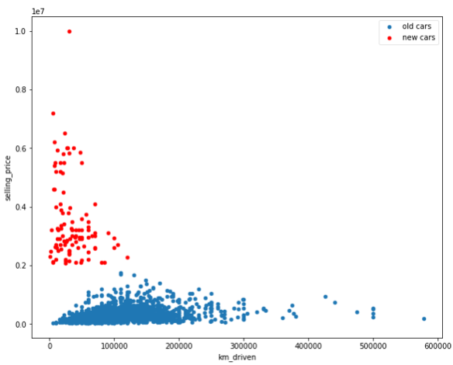
Comparing 2 clusters

Slide 17
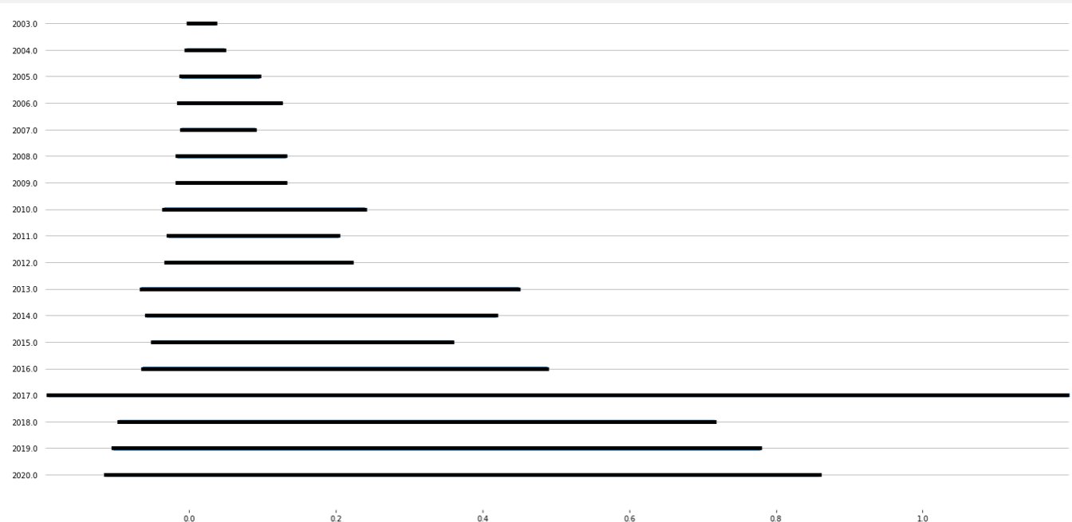
Joy plot to show the selling price increases as the car age is less.
The cars which are new model and km-driven is very less have the more selling price.
the selling price drops as the car gets older and increasing km-driven

Slide 18
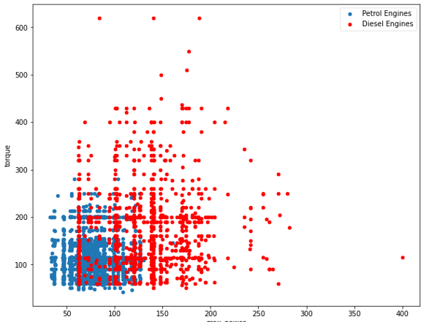
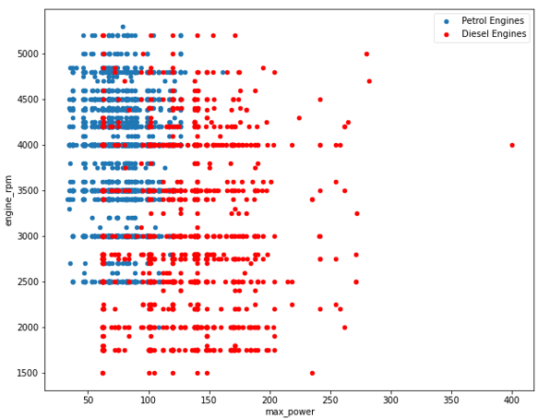
Comparison of 2 clusters From the clustering, we can analyze that Petrol engines(cluster 0) has higher rpm which means more fuel burnt and low torque. Diesel engines (Cluster 2) has the higher torque with low rpm to give more mileage. Concluding the clusters, Diesel engines are better than petrol is that the power in diesel is high and the heat capacity is also high. So, it runs on less rpm and produce high torque to give a better mileage and horsepower.

Slide 19
Thank You..
Questions?

